Slide 1

Week #6
AI Academy®
1
Day 1, 2, 3:
PHP Functions
Why we use?
PHP Arrays
Array Sorting with Functions
PHP Forms & DB Connectivity
Reviews & Feedbacks

Slide 2
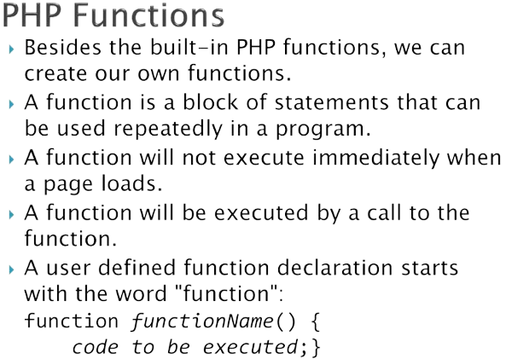
Week #6
AI Academy®
2

Slide 3
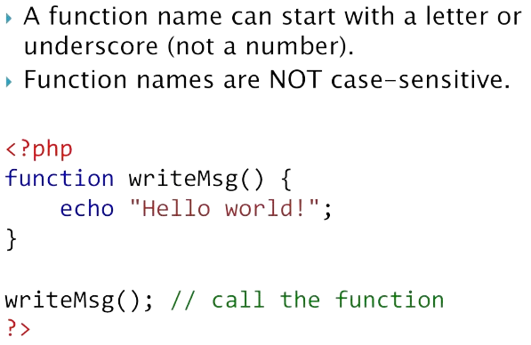
Week #6
AI Academy®
3

Slide 4
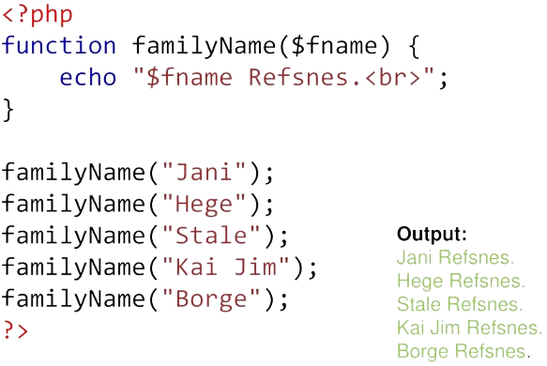
Week #6
AI Academy®
4

Slide 5
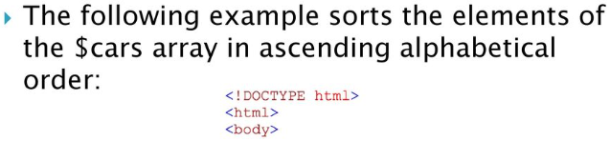
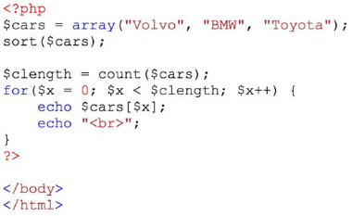
Week #6
AI Academy®
5

Slide 6
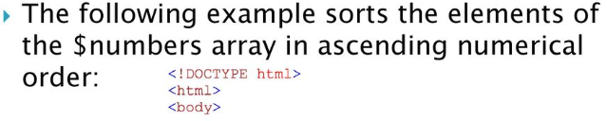
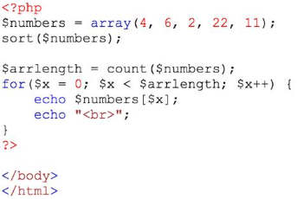
Week #6
AI Academy®
6

Slide 7
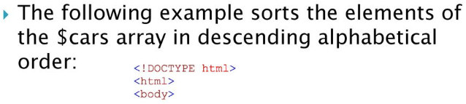
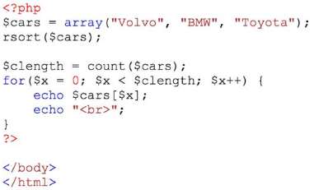
Week #6
AI Academy®
7

Slide 8
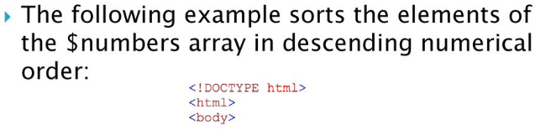
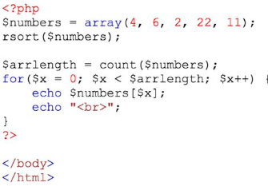
Week #6
AI Academy®
8

Slide 9

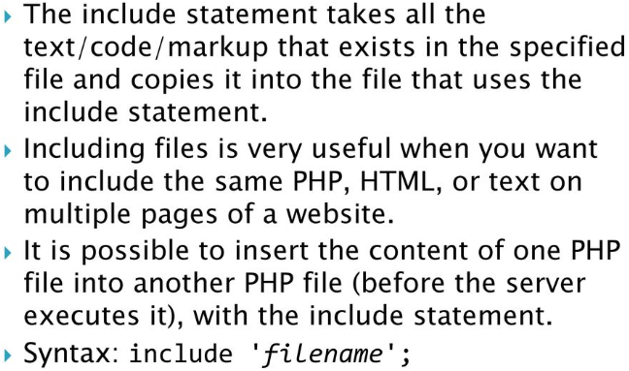
Week #6
AI Academy®
9

Slide 10
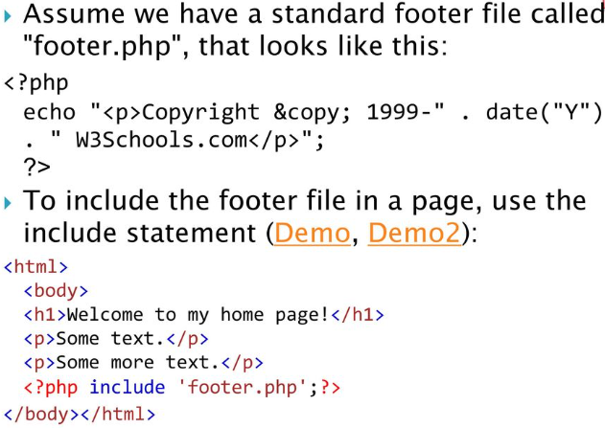
Week #6
AI Academy®
10

Slide 11
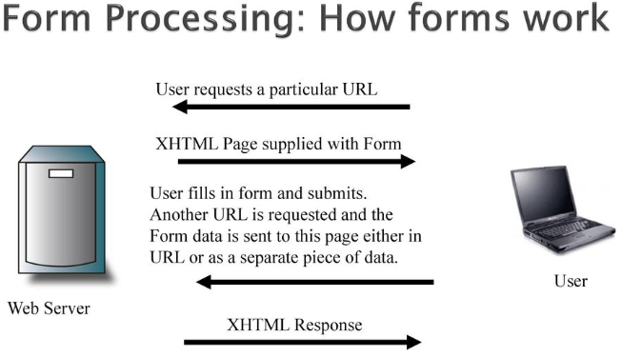
Week #6
AI Academy®
11

Slide 12

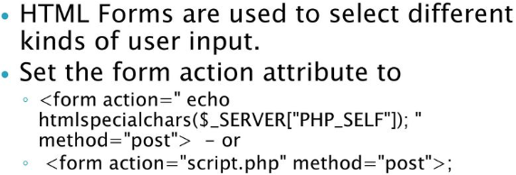
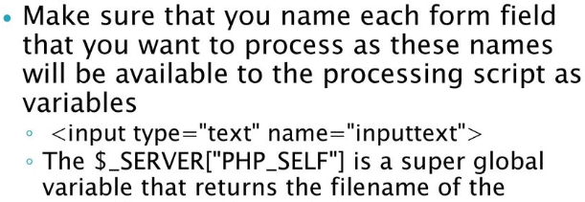
Week #6
AI Academy®
12

Slide 13

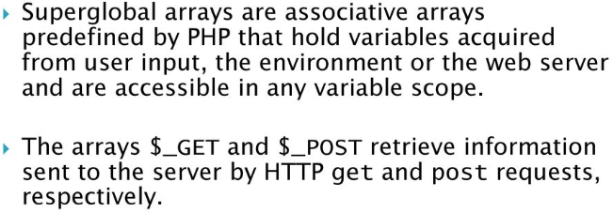
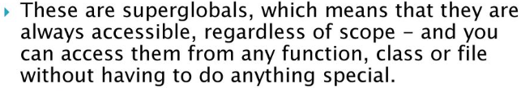
Week #6
AI Academy®
13

Slide 14
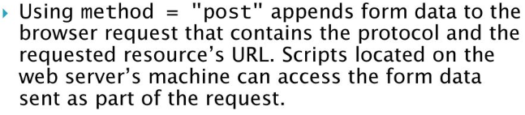
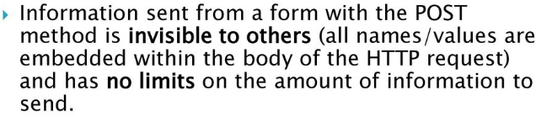
Week #6
AI Academy®
14
Form Coding Updated on Github!

Slide 15
Week #6
AI Academy®
15
Day 4, 5:
Mid Term Assessment
Project Presentation
Reviews & Feedbacks

